Slide 1
Data Link Layer
Acadimic Purpose Only (KIET CN SKK IT VI)

Slide 2

Position of the data-link layer
Acadimic Purpose Only (KIET CN SKK IT VI)

Slide 3
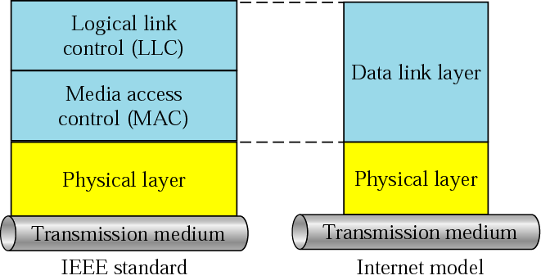
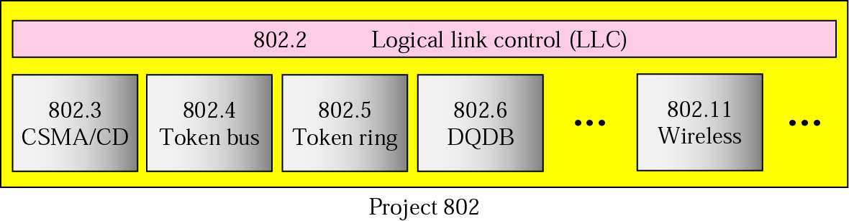
IEEE standard
Acadimic Purpose Only (KIET CN SKK IT VI)

Slide 4
Data Link layer
Acadimic Purpose Only (KIET CN SKK IT VI)

Slide 5
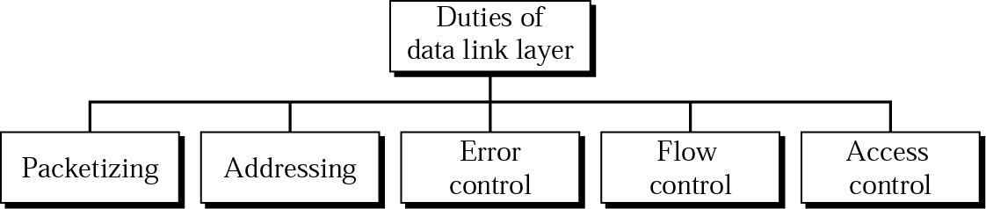
Data link layer duties
Acadimic Purpose Only (KIET CN SKK IT VI)

Slide 6
Data Link layer
Acadimic Purpose Only (KIET CN SKK IT VI)

Slide 7
Packetizing (Framing)
Framing is specific to the data link layer.
Upper-layer protocols also divide data into discernible “packets” of information, but the terminology used to define packets at each layer is different:
  Message The actual application data, command, or instruction encapsulated within a TCP segment assuming TCP is used.
  Segment The packet of information exchanged between two peers that contains TCP information. TCP exchanges segments.
  Datagram The packet of information exchanged between two peers containing network layer protocol information. IP exchanges datagrams.
  Frame The packet of information at the data link layer. Frames encapsulate datagrams.
Acadimic Purpose Only (KIET CN SKK IT VI)

Slide 8
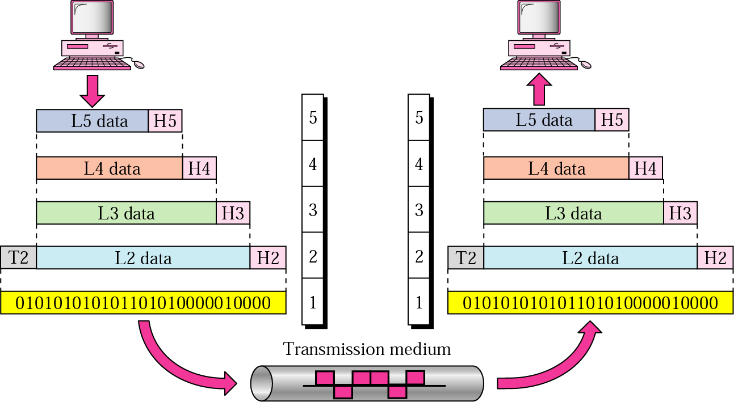
REMINDER:
message
segment
Application
datagram
Transport
frame
Network
Data link
Physical
Acadimic Purpose Only (KIET CN SKK IT VI)

Slide 9
Framing
Data transmission in the physical layer means moving bits in the form of a signal from the source to the destination. The physical layer provides bit synchronization to ensure that the sender and receiver use the same bit durations and timing.
The data link layer, on the other hand, needs to pack bits into frames, so that each frame is distinguishable from another. Our postal system practices a type of framing. The simple act of inserting a letter into an envelope separates one piece of information from another; the envelope serves as the delimiter. In addition, each envelope defines the sender and receiver addresses since the postal system is a many-to-many carrier facility.
Framing in the data link layer separates a message from one source to a destination,
or from other messages to other destinations, by adding a sender address and a destination address. The destination address defines where the packet is to go; the sender address helps the recipient acknowledge the receipt.
Although the whole message could be packed in one frame, that is not normally done. One reason is that a frame can be very large, making flow and error control very inefficient. When a message is carried in one very large frame, even a single-bit error would require the retransmission of the whole message. When a message is divided into smaller frames, a single-bit error affects only that small frame.
Acadimic Purpose Only (KIET CN SKK IT VI)

Slide 10
Framing
Fixed-Size Framing
Frames can be of fixed or variable size. In fixed-size framing, there is no need for defining the boundaries of the frames; the size itself can be used as a delimiter. An example of this type of framing is the ATM wide-area network, which uses frames of fixed size called cells.
Variable-Size Framing
Our main discussion in this chapter concerns variable-size framing, prevalent in local area networks. In variable-size framing, we need a way to define the end of the frame and the beginning of the next. Historically, two approaches were used for this purpose: a character-oriented approach and a bit-oriented approach.
Acadimic Purpose Only (KIET CN SKK IT VI)

Slide 11
Framing
Methods devised:
• Character count (Byte Count)
• Starting , ending characters with character stuffing (Byte Stuffing)
• Starting and ending characters with bit stuffing.
Acadimic Purpose Only (KIET CN SKK IT VI)

Slide 12
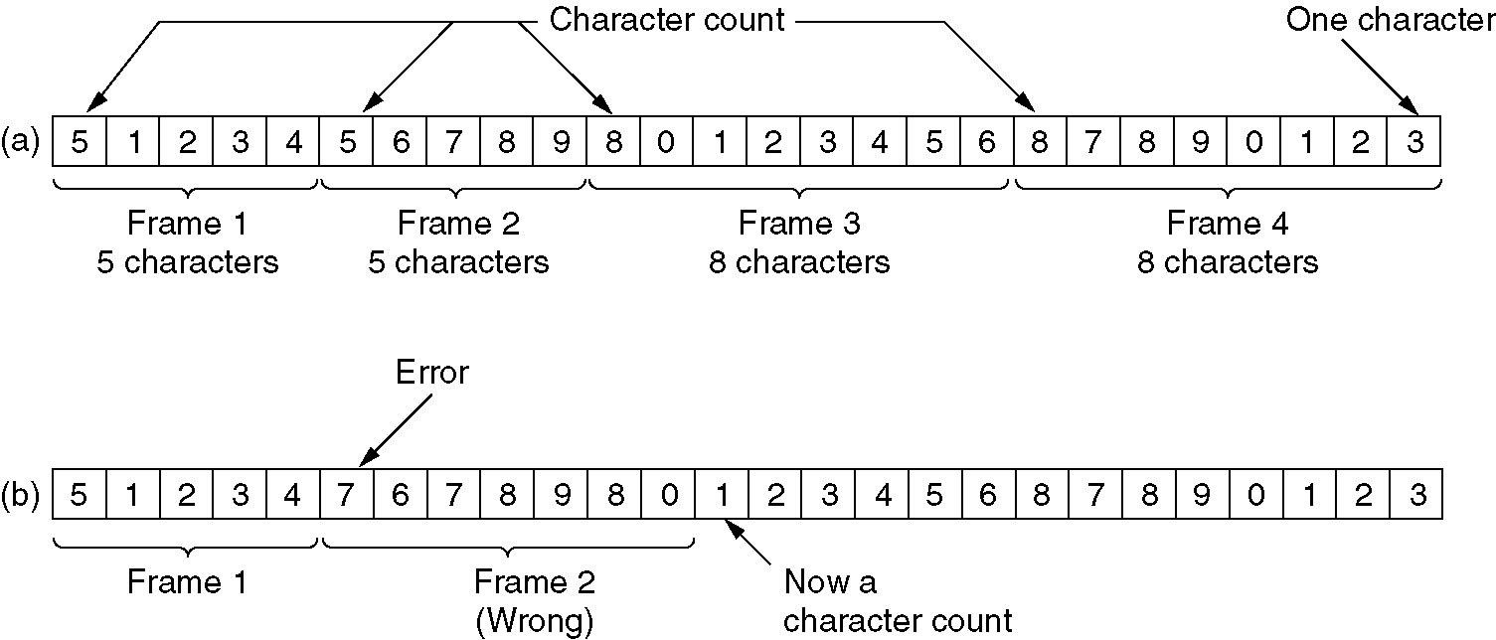
Byte count
A stream encoded with byte count
  without errors
  with errors
Note: difficult to resynchronize
Acadimic Purpose Only (KIET CN SKK IT VI)

Slide 13
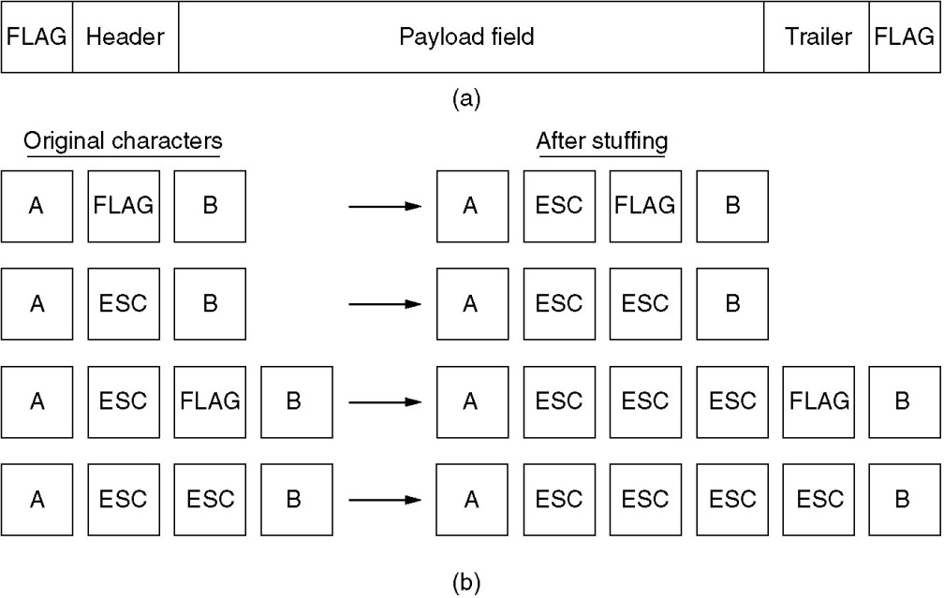
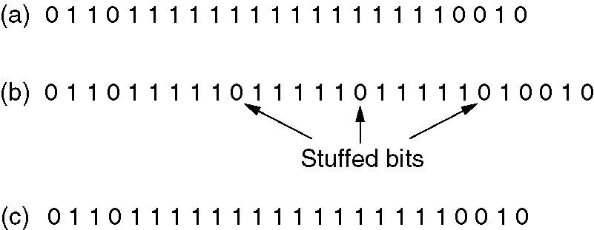
Stuffing
Acadimic Purpose Only (KIET CN SKK IT VI)

Slide 14
Data Link layer
Acadimic Purpose Only (KIET CN SKK IT VI)

Slide 15
Error Detection
and
Correction
Acadimic Purpose Only (KIET CN SKK IT VI)

Slide 16

Note:
Data can be corrupted during transmission. For reliable communication, errors must be detected and corrected.
Acadimic Purpose Only (KIET CN SKK IT VI)

Slide 17
Types of Error
Single-Bit Error
Burst Error
Acadimic Purpose Only (KIET CN SKK IT VI)

Slide 18
Note:
In a single-bit error, only one bit in the data unit has changed.
Acadimic Purpose Only (KIET CN SKK IT VI)

Slide 19
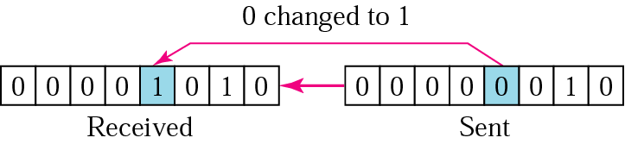
Single-bit error
Acadimic Purpose Only (KIET CN SKK IT VI)

Slide 20
Note:
A burst error means that 2 or more bits in the data unit have changed.
Acadimic Purpose Only (KIET CN SKK IT VI)

Slide 21
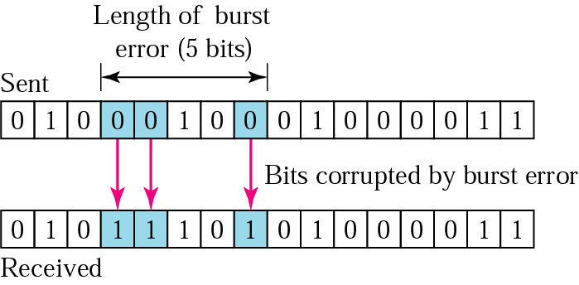
Burst error of length 5
Acadimic Purpose Only (KIET CN SKK IT VI)

Slide 22
Detection
Redundancy
Parity Check
Cyclic Redundancy Check (CRC)
Checksum
Acadimic Purpose Only (KIET CN SKK IT VI)

Slide 23
Note:
Error detection uses the concept of redundancy, which means adding extra bits for detecting errors at the destination.
Acadimic Purpose Only (KIET CN SKK IT VI)

Slide 24
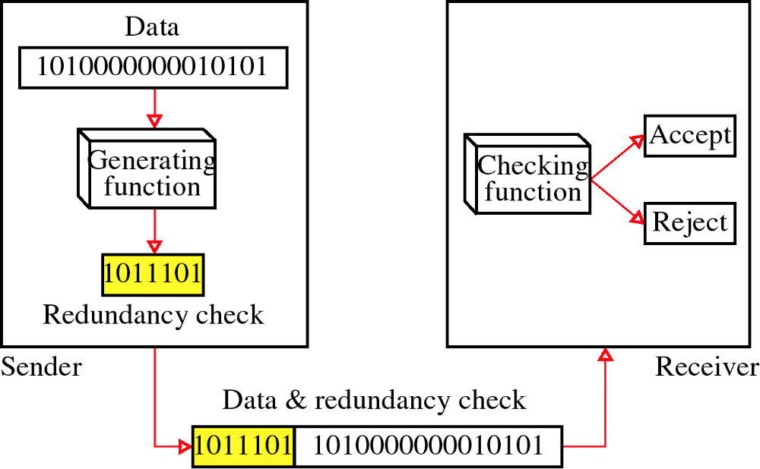
Redundancy
Acadimic Purpose Only (KIET CN SKK IT VI)

Slide 25
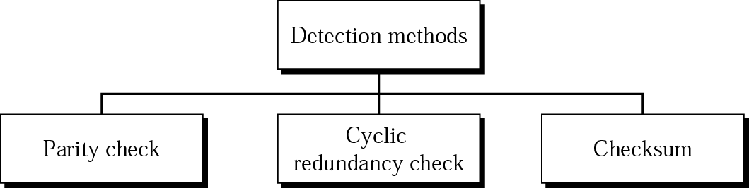
Detection methods
Acadimic Purpose Only (KIET CN SKK IT VI)

Slide 26
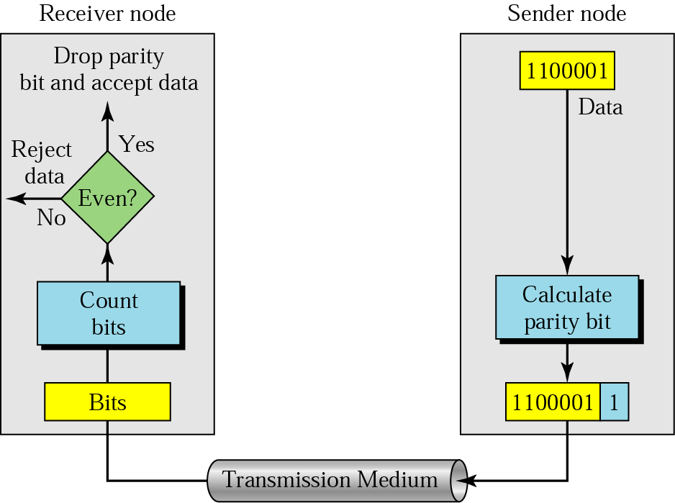
Even-parity concept
Acadimic Purpose Only (KIET CN SKK IT VI)

Slide 27
Note:
In parity check, a parity bit is added to every data unit so that the total number of 1s is even
(or odd for odd-parity).
Acadimic Purpose Only (KIET CN SKK IT VI)

Slide 28
Example 1
Suppose the sender wants to send the word world. In ASCII the five characters are coded as
1110111 1101111 1110010 1101100 1100100
The following shows the actual bits sent
11101110 11011110 11100100 11011000 11001001
Acadimic Purpose Only (KIET CN SKK IT VI)

Slide 29
Example 2
Now suppose the word world in Example 1 is received by the receiver without being corrupted in transmission.
11101110 11011110 11100100 11011000 11001001
The receiver counts the 1s in each character and comes up with even numbers (6, 6, 4, 4, 4). The data are accepted.
Acadimic Purpose Only (KIET CN SKK IT VI)

Slide 30
Example 3
Now suppose the word world in Example 1 is corrupted during transmission.
11111110 11011110 11101100 11011000 11001001
The receiver counts the 1s in each character and comes up with even and odd numbers (7, 6, 5, 4, 4). The receiver knows that the data are corrupted, discards them, and asks for retransmission.
Acadimic Purpose Only (KIET CN SKK IT VI)

Slide 31
Note:
Simple parity check can detect all single-bit errors. It can detect burst errors only if the total number of errors in each data unit is odd.
Acadimic Purpose Only (KIET CN SKK IT VI)

Slide 32
Example 4
Suppose the following block is sent:
10101001 00111001 11011101 11100111 10101010
However, it is hit by a burst noise of length 8, and some bits are corrupted.
10100011 10001001 11011101 11100111 10101010
When the receiver checks the parity bits, some of the bits do not follow the even-parity rule and the whole block is discarded.
10100011 10001001 11011101 11100111 10101010
Acadimic Purpose Only (KIET CN SKK IT VI)

Slide 33
Note:
In two-dimensional parity check, a block of bits is divided into rows and a redundant row of bits is added to the whole block.
Acadimic Purpose Only (KIET CN SKK IT VI)

Slide 34
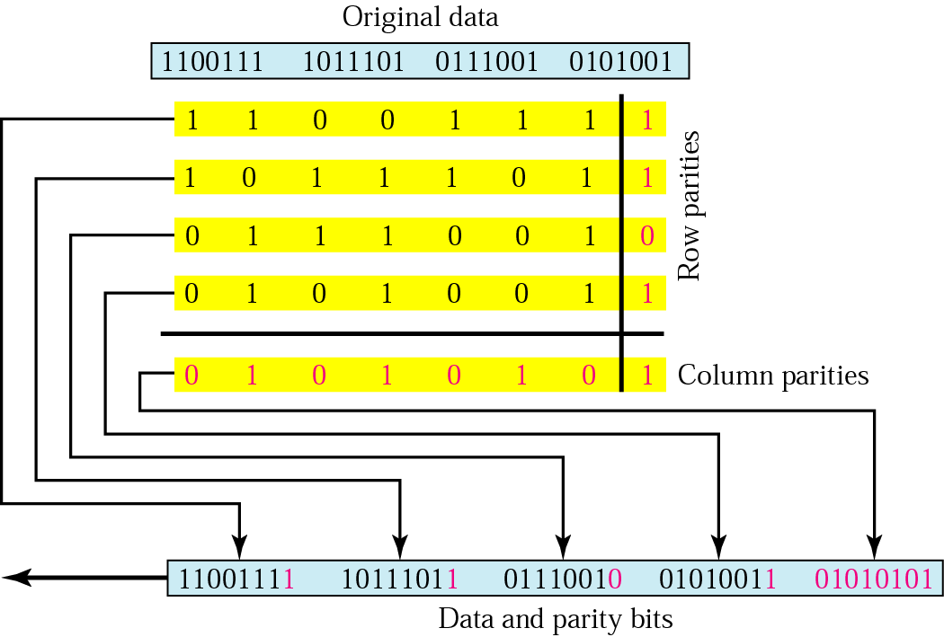
Two-dimensional parity
Acadimic Purpose Only (KIET CN SKK IT VI)

Slide 35
CYCLIC CODES
Cyclic codes are special linear block codes with one extra property. In a cyclic code, if a codeword is cyclically shifted (rotated), the result is another codeword.

Slide 36
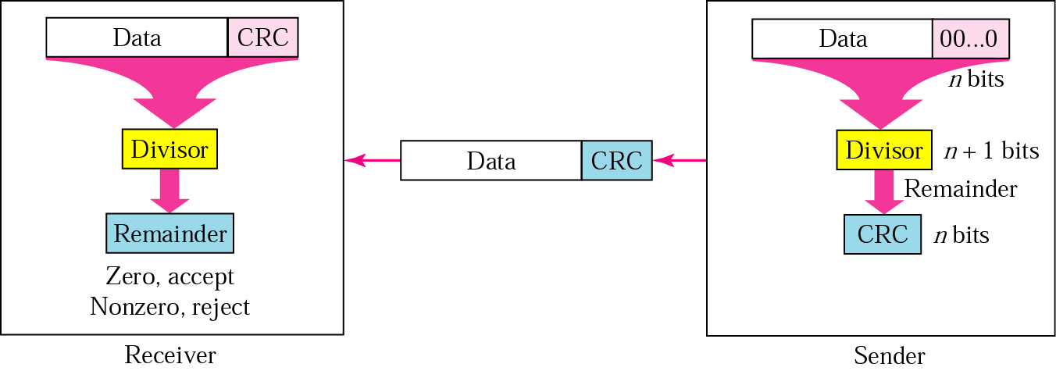
CRC generator and checker
Acadimic Purpose Only (KIET CN SKK IT VI)

Slide 37
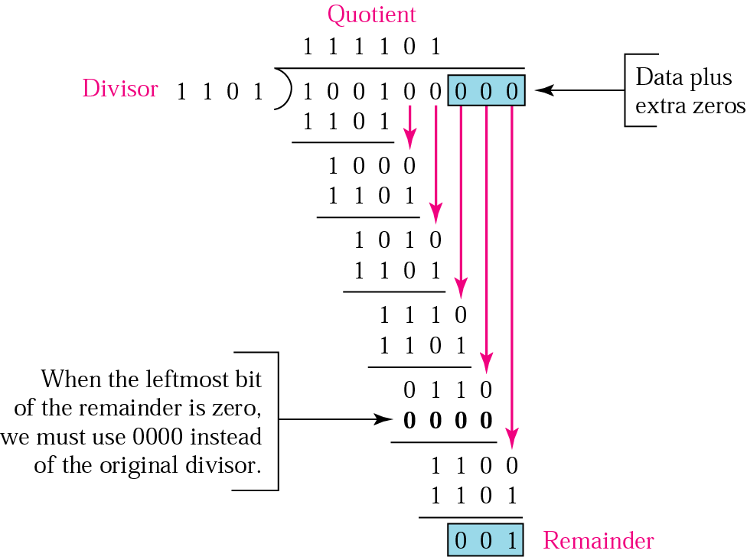
Binary division in a CRC generator
Acadimic Purpose Only (KIET CN SKK IT VI)

Slide 38
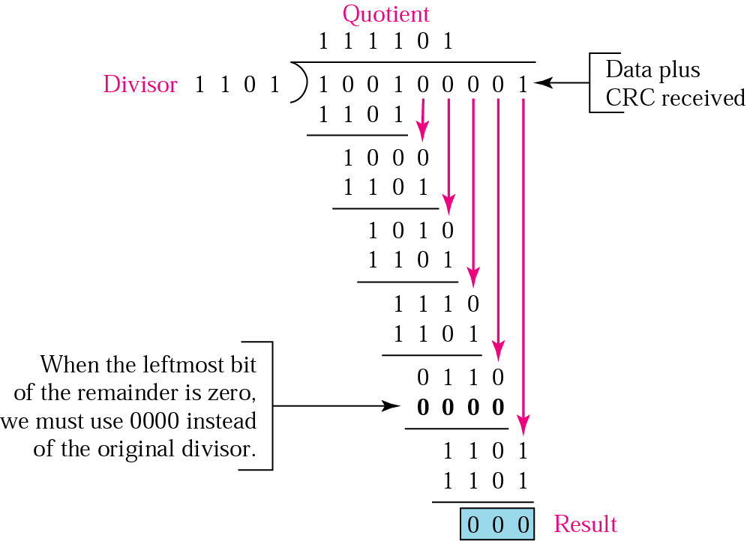
Binary division in CRC checker
Acadimic Purpose Only (KIET CN SKK IT VI)

Slide 39

Division in CRC encoder

Slide 40

Division in the CRC decoder for two cases

Slide 41
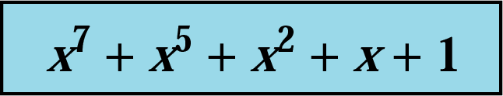
A polynomial
Acadimic Purpose Only (KIET CN SKK IT VI)

Slide 42
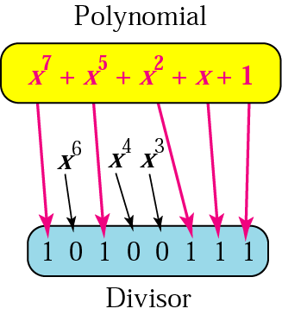
A polynomial representing a divisor
Acadimic Purpose Only (KIET CN SKK IT VI)

Slide 43
Table Standard polynomials
Name | Polynomial | Application
CRC-8 | x⁸ + x² + x + 1 | ATM header
CRC-10 | x¹⁰ + x⁹ + x⁵ + x⁴ + x ² + 1 | ATM AAL
ITU-16 | x¹⁶ + x¹² + x⁵ + 1 | HDLC
ITU-32 | x³² + x²⁶ + x²³ + x²² + x¹⁶ + x¹² + x¹¹ + x¹⁰ + x⁸ + x⁷ + x⁵ + x⁴ + x² + x + 1 | LANs
Acadimic Purpose Only (KIET CN SKK IT VI)

Slide 44
CHECKSUM
The last error detection method we discuss here is called the checksum. The checksum is used in the Internet by several protocols although not at the data link layer. However, we briefly discuss it here to complete our discussion on error checking

Slide 45
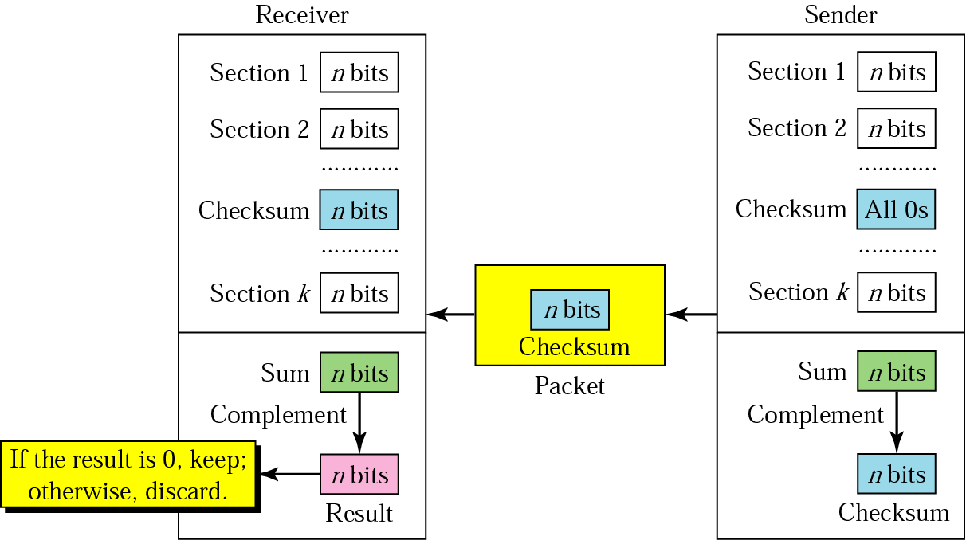
Checksum
Acadimic Purpose Only (KIET CN SKK IT VI)

Slide 46
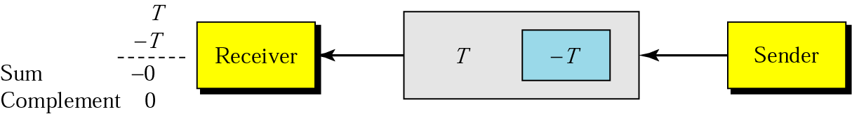
Data unit and checksum
Acadimic Purpose Only (KIET CN SKK IT VI)

Slide 47
Note:
The sender follows these steps:
The unit is divided into k sections, each of n bits.
All sections are added using one’s complement to get the sum.
The sum is complemented and becomes the checksum.
The checksum is sent with the data.
Acadimic Purpose Only (KIET CN SKK IT VI)

Slide 48
Note:
The receiver follows these steps:
The unit is divided into k sections, each of n bits.
All sections are added using one’s complement to get the sum.
The sum is complemented.
If the result is zero, the data are accepted: otherwise, rejected.
Acadimic Purpose Only (KIET CN SKK IT VI)

Slide 49
Example 7
Suppose the following block of 16 bits is to be sent using a checksum of 8 bits.
10101001 00111001
The numbers are added using one’s complement
10101001
00111001
------------
Sum 11100010
Checksum 00011101
The pattern sent is 10101001 00111001 00011101
Acadimic Purpose Only (KIET CN SKK IT VI)

Slide 50
Example 8
Now suppose the receiver receives the pattern sent in Example 7 and there is no error.
10101001 00111001 00011101
When the receiver adds the three sections, it will get all 1s, which, after complementing, is all 0s and shows that there is no error.
10101001
00111001
00011101
Sum 11111111
Complement 00000000 means that the pattern is OK.
Acadimic Purpose Only (KIET CN SKK IT VI)

Slide 51
Example 9
Now suppose there is a burst error of length 5 that affects 4 bits.
10101111 11111001 00011101
When the receiver adds the three sections, it gets
10101111
11111001
00011101
Partial Sum 1 11000101
Carry 1
Sum 11000110
Complement 00111001 the pattern is corrupted.
Acadimic Purpose Only (KIET CN SKK IT VI)

Slide 52
Correction
Forward Error Correction
Burst Error Correction
Retransmission
Acadimic Purpose Only (KIET CN SKK IT VI)

Slide 53
Table Data and redundancy bits
Number of data bits m | Number of redundancy bits r | Total bits m + r
1 | 2 | 3
2 | 3 | 5
3 | 3 | 6
4 | 3 | 7
5 | 4 | 9
6 | 4 | 10
7 | 4 | 11
Acadimic Purpose Only (KIET CN SKK IT VI)

Slide 54
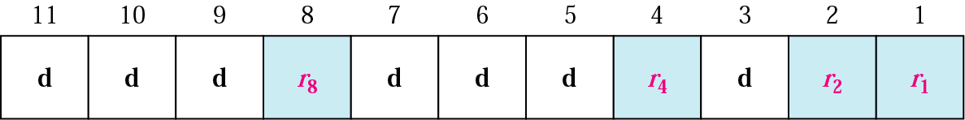
Positions of redundancy bits in Hamming code
Acadimic Purpose Only (KIET CN SKK IT VI)

Slide 55
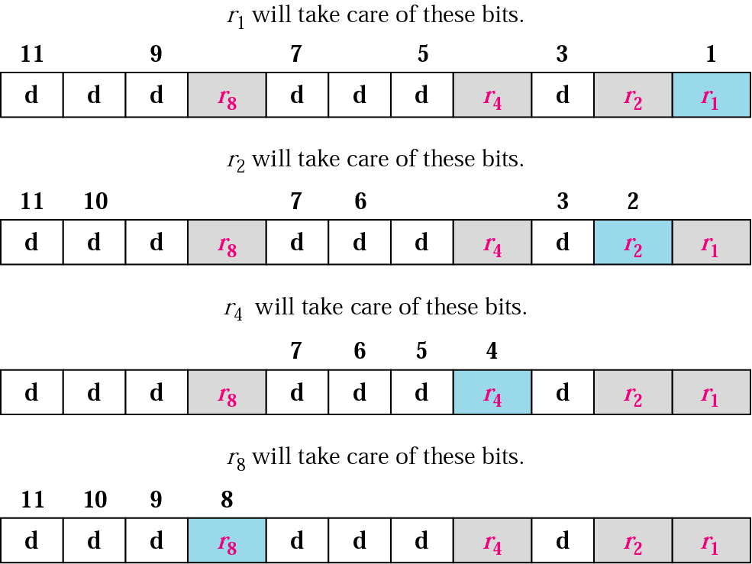
Redundancy bits calculation
Acadimic Purpose Only (KIET CN SKK IT VI)

Slide 56
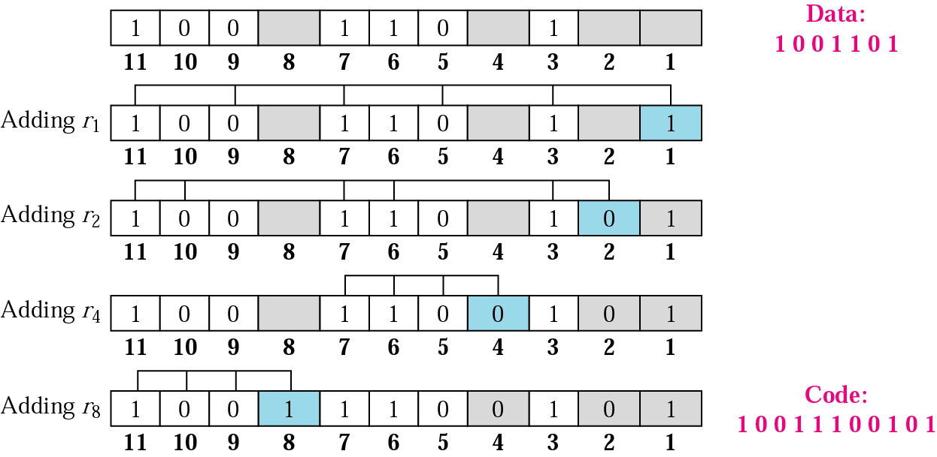
Example of redundancy bit calculation
Acadimic Purpose Only (KIET CN SKK IT VI)

Slide 57
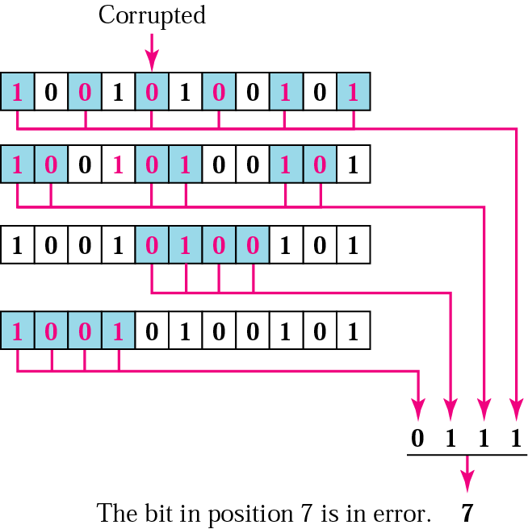
Error detection using Hamming code
Acadimic Purpose Only (KIET CN SKK IT VI)

